Slide 1
Introduction to Web
Dimitar Nenchev
dimitar.nenchev@cayetanogaming.com
Ivan Nakov
Ivan.nakov@cayetanogaming.com

Slide 2
Agenda
Web application architecture
Popular frameworks
Creating maven project
Hibernate
Spring
JSF

Slide 3
What is Web Application?
HTML and dynamic pages – JSP, XHTML
Servlets
Resources – images, css, javascript etc
Business and Database logic
WAR file

Slide 4
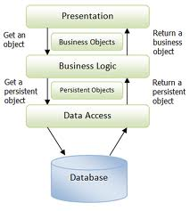
Application Layers

Slide 5
Popular Frameworks
Database: MySql, Postgresql
ORM: Hibernate, Ibatis, JPA
Services: EJB, Spring
Web: JSP, XHTML
Struts, GWT, JSF Primefaces

Slide 6
Popular Frameworks

Slide 7
How to start?
Technologies:
JDK 7
Postgres 9.x / MySql 5.5.x
Maven 3.0.x
Hibernate 4.1.x
Spring 3.2
Primefaces 3.1.x
Tomcat 7

Slide 8
What is Maven?
Modern build/project management tool
pom.xml
.m2 repo
Maven eclipse plugin
Maven war plugin
Notes:
Versioning, artefacts, module reusability, convensions

Slide 9
What is ORM?
In relational databases, business entities are represented as tables
In object-oriented languages, business entities are represented as classes
OO
Programming
Language
(classes)
ORM
Framework
Relational
Database
(tables)

Slide 10
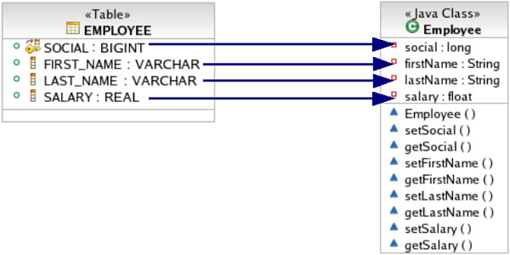
Example

Slide 11
Hibernate Advantages
Mature Open Source framework
Portability
Optimized Performance
Reduces Development time
Reduce complexity
Support Query Language
Integration with many popular frameworks
Notes:
Maps classes to tables and java types to sql data types

Slide 12
What is Spring
Mature Open Source framework
Lightweight solution for enterprise apps
Non-invasive (POJO based)
Modular
Integration with many popular frameworks

Slide 13
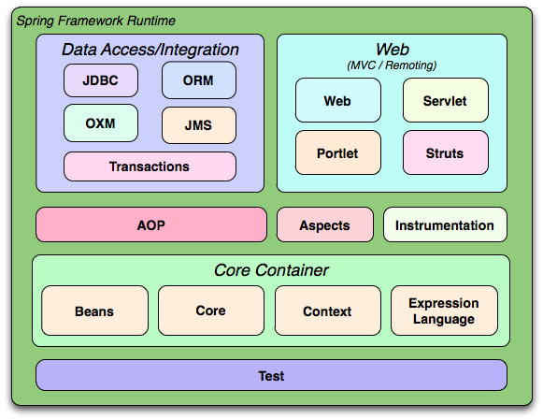
Spring Modules

Slide 14
IoC and DI
“Don’t call me, I’ll call you”
DI is form of IoC
DI variants
Constructor injection
Setter injection

Slide 15
Terms
Application Context
Represents the Spring IoC container
Bean
Object managed by Spring IoC Container
Bean Definition
Describe a bean instance

Slide 16
Bean Scopes
Simple
Singleton
Prototype
Runtime
Thread
Custom implementation
Web-aware scopes
Request
Session
Global Session

Slide 17
Transactions
What is Transaction?
Spring Declarative transaction management
Transaction Propagation
Required
RequeresNew
Supports
NotSupported
Nested
Mandatory
Never
ReadOnly

Slide 18
What is JSF?
Request driven MVC web framework
Component oriented UI design model
Event driven
Easy to use ajax support
Templating support
Zero Config
Component libraries

Slide 19
Primefaces
Open source
Lightweight
Easy to use
Rich Components

Slide 20
Contest

Slide 21
Questions?

